Slide 1

16th International IEEE Conference on Computing, Communication and Networking Technologies (ICCCNT 2025)
Oil Spill Detection Using Deep Learning
A Comparison of U-Net, DeepLabV3 & PSPNet
Dr. Saranya G
Assistant Professor, NWC Dept.
SRMIST KTR
GUIDE NAME
Devroop Das
Gavish Kumar
Harshit
STUDENT TEAM
Notes:
Good afternoon everyone, I am Devroop Das, a B.Tech student in Computer Science and Engineering with a specialization in IT at SRM Institute of Science and Technology, Kattankulathur, and I’m delighted to present our research titled "Landslide Detection and Mapping with Satellite Imagery: A Machine Learning Approach". This project is a collaborative effort by our team at SRM KTR, and it addresses one of the critical challenges in disaster management which is landslide detection.
Before diving into the details, let me briefly outline the flow of today’s presentation.

Slide 2
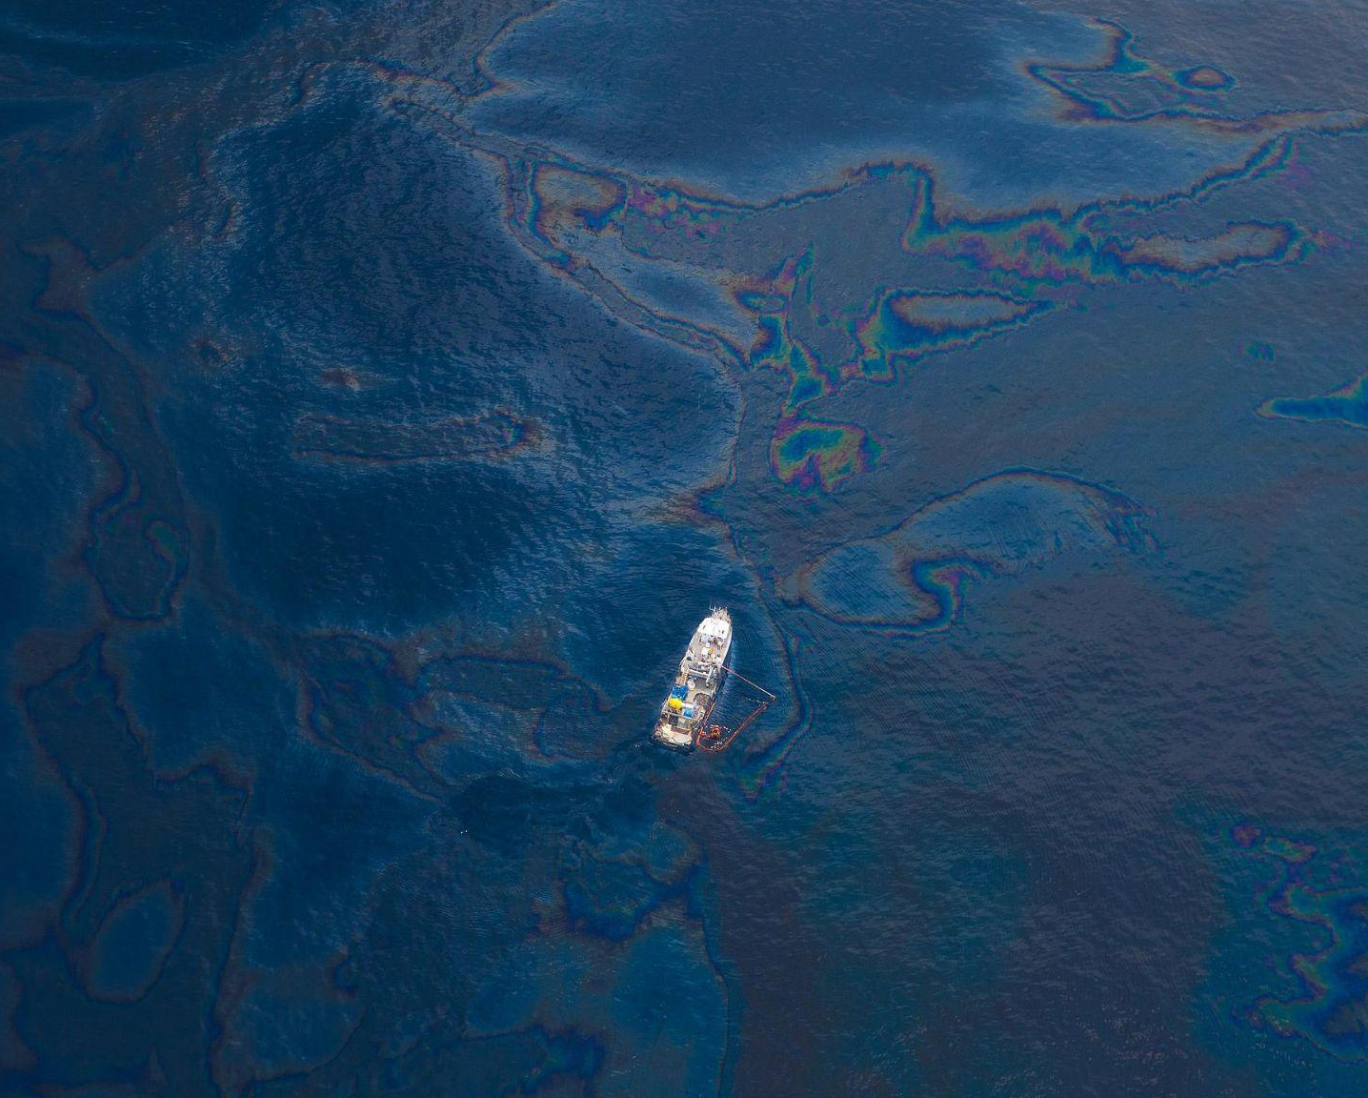
PROBLEM STATEMENT
Why Detect Oil Spills?
Oil spills cause catastrophic environmental damage
Traditional detection is slow, weather-dependent, and expensive
Deep learning offers a fast, automated solution

Slide 3
ABSTRACT
Oil spillage in marine environments is a curse of both the existing marine life and the global trade. Timely prevention and detection of such cases is crucial for effective systems. This study presents a comparative assessment of three of the current best architectures in deep learning - U-Net, DeepLab V3, and PSPNet — for oil spill detection using satellite imagery. Our results indicate that DeepLabV3 was the best in detection accuracy, as indicated by an F1-score of 95.33%, followed by U-Net with 94.75% and PSPNet with 89.93%. Additionally, U-Net showed the highest inference speed, processing images in an average time of 0.56 seconds. The novelty in this work is due to the comparative analysis of these architectures to have an insight into their efficiency for real-time environmental monitoring. The results show the potential of AI based systems which contribute to effective identification and monitoring of spills and correct cleanup later. Index Terms—Oil Spill Detection, Deep Learning, Remote Sensing, U-Net, DeepLab V3, PSPNet

Slide 4

RESEARCH OBJECTIVES
Compare U-Net, DeepLab V3, and PSPNet for oil spill detection
Evaluate performance on a real-world satellite dataset
Measure accuracy, speed, and segmentation quality

Slide 5

RESEARCH GAPS
Most previous works used only one model, lacking comparative analysis
Many studies focused on synthetic or non-public datasets, reducing reproducibility
Limited attention to real-time inference speed, which is crucial for deployment
Attention mechanisms not widely explored in oil spill detection
Few works addressed model behavior in diverse spill shapes and noise levels

Slide 6
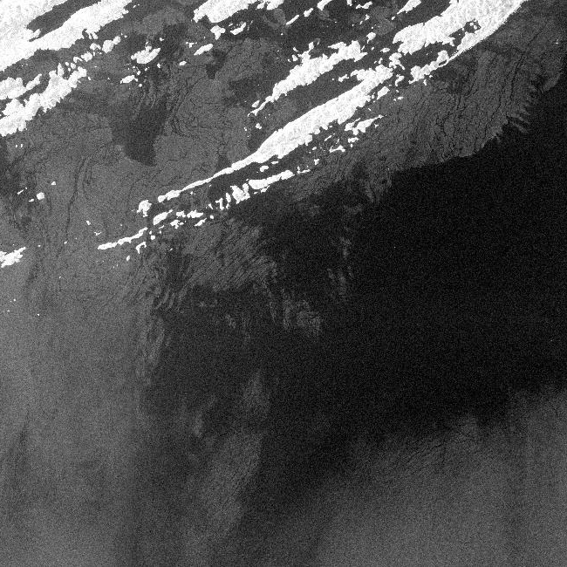
DATASET OVERVIEW
Kaggle dataset of satellite images with oil spill masks
Diverse locations, weather conditions, and spill types
Image size: 256×256, paired with segmentation masks

Slide 7
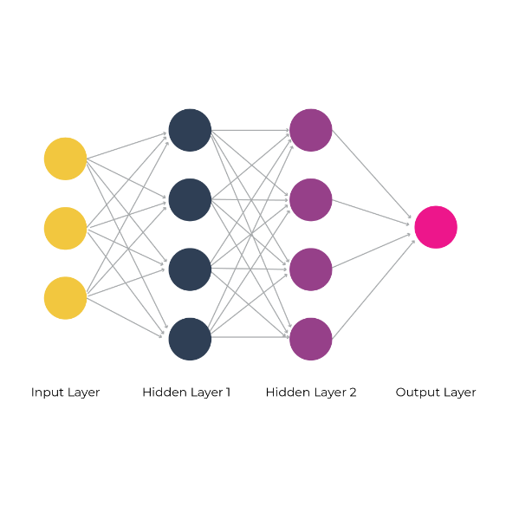
DEEP LEARNING MODELS
U-Net: Fast and efficient, uses encoder-decoder with skip connections
DeepLab V3: High accuracy with ASPP and atrous convolution
PSPNet: Good generalization with pyramid pooling

Slide 8
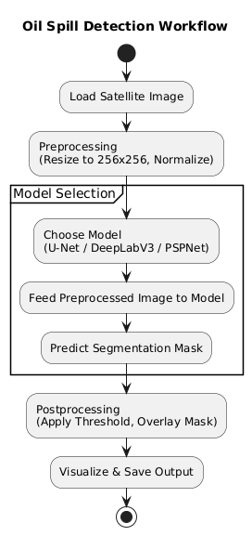

Slide 9
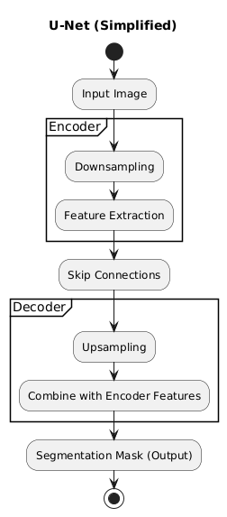

Slide 10
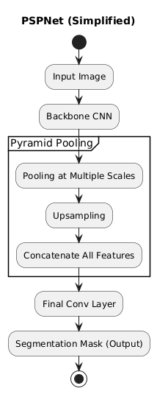

Slide 11
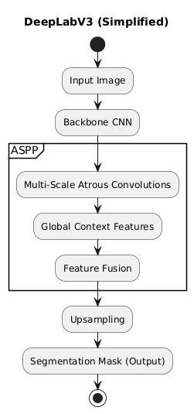

Slide 12

TRAINING SETUP
Platform: Google Collab with L4 GPU
Loss: Binary Cross-Entropy
Optimizer: Adam (lr = 1e-4)
Epochs: 50, Batch Size: 8
Early Stopping + LR Reduction

Slide 13
EVALUATION METRICS
Accuracy: Measures the proportion of correctly predicted pixels (both oil and non-oil).
Formula: (TP + TN) / (TP + TN + FP + FN)
F1-Score: Harmonic mean of precision and recall. Balances false positives and false negatives.
Especially important in imbalanced datasets
High F1 = reliable detection of oil spills
IoU (Intersection over Union): Evaluates overlap between predicted and actual spill regions.
Formula: TP / (TP + FP + FN)
Inference Time: Measures how fast a model can process one image.
U-Net was the fastest in our experiments

Slide 14
QUANTITATIVE RESULTS
Model | Accuracy | F1-Score | IoU | Time (s)
U-Net | 94.6% | 94.75% | 0.89 | 0.56
Deeplab V3 | 95.3% | 95.43% | 0.91 | 0.79
PSPNet | 89.3% | 89.94% | 0.81 | 0.84

Slide 15
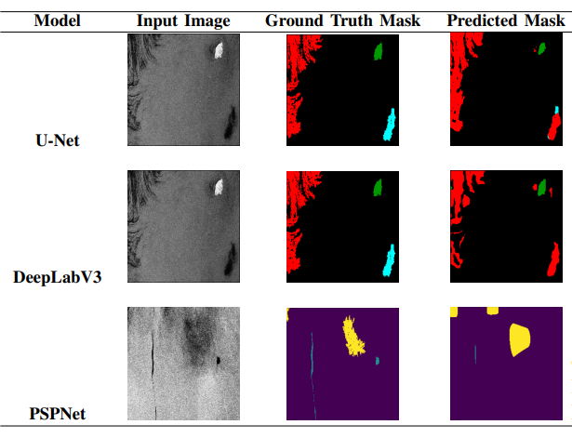
QUALITATIVE RESULT

Slide 16
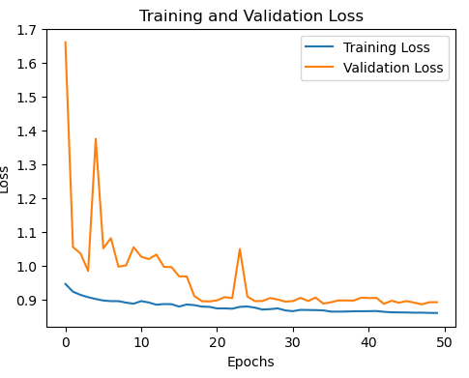
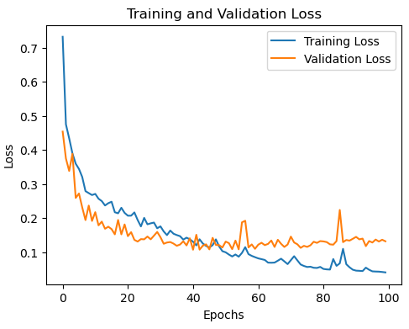
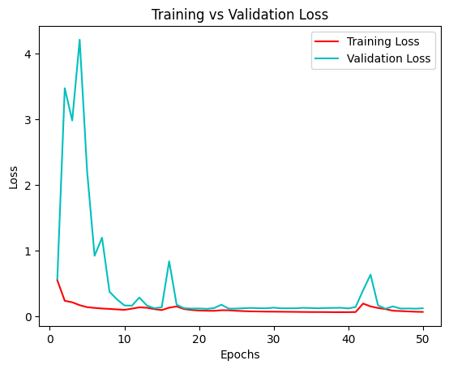
TRAINING & VALIDATION LOSS
U-Net Loss Curve
Deeplab V3 Loss Curve
PSPNet Loss Curve

Slide 17
OBSERVATIONS
Model | Strength | Limitation
DeepLab V3 | High accuracy, boundary clarity | Slower than U-Net
U-Net | Fast, good general localization | May miss finer segmentation detail
PSPNet | Handles large regions well | Weaker with small spills

Slide 18
FUTURE WORK
Add attention modules (CBAM, SE block)
Try hybrid models like U-Net + DeepLabV3
Add multi-class classification
Use domain adaptation for different satellite types

Slide 19
CONCLUSION
Deep learning is highly effective for oil spill detection
DeepLab V3 is the most accurate model
U-Net is ideal for real-time applications
PSPNet is robust in diverse conditions

Slide 20
REFERENCES
[1] Fingas, M. (2018). A Review of Oil Spill Remote Sensing. Sensors, 18(1), 91.
[2] Brekke, C., & Solberg, A. H. S. (2005). Oil Spill Detection by Satellite Remote Sensing. Remote Sensing of Environment, 95(1), 1-13.
[3] Keramitsoglou, I., & Cartalis, C. (2008). Decision Support System for Management of Oil Spills Using SAR Imagery and AIS Data. Environmental Management, 42(4), 611-619.
[4] Topouzelis, K., Singha, S. S., & Tarchi, D. (2009). Detection of Oil Spills and Underwater Natural Gas Seeps Using Satellite Remote Sensing. Remote Sensing, 1(3), 567-577.
[5] Ferraro, G., Bernardini, A., David, M., Meyer-Roux, S., Muellenhoff, O., Perkovic, M., Tarchi, D., & Topouzelis, K. (2009). Towards an Operational Use of Space Imagery for Oil Pollution Monitoring in the Mediterranean Basin: Experience Gained from the EMERALD Project. Sensors, 9(1), 95-107.

Slide 21
REFERENCES
[[6] Migliaccio, M., Nunziata, F., & Buono, A. (2015). SAR Polarimetry for Sea Oil Slick Observation. International Journal of Remote Sensing, 36(12), 3243-3273.
[7] Garcia-Pineda, O., MacDonald, I. R., & Li, X. (2013). Oil Spill Mapping and Measurement in the Gulf of Mexico with Textural Classifier Neural Network Algorithm (TCNNA) Applied to SAR Imagery. Remote Sensing of Environment, 130, 212-221.
[8] Li, J., Huang, W., & Tian, Q. (2016). Oil Spill Detection Using Fully Polarimetric SAR Data and Semi-Supervised Learning. Remote Sensing, 8(8), 633.
[9] Mazzarella, F., Vespe, M., & Tarchi, D. (2016). Knowledge-Based Vessel Position Prediction Using Historical AIS Data. IEEE Transactions on Intelligent Transportation Systems, 17(8), 2367-2377.
[10] Fiscella, B., Giancaspro, A., Nirchio, F., Pavese, P., & Trivero, P. (2000). Oil Spill Detection Using Marine SAR Images. International Journal of Remote Sensing, 21(18), 3561-3566.

Slide 22
Thank You!

